Slide 1
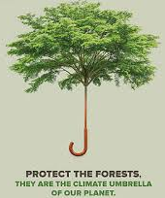

FOR
CLIMATE CHANGE

Slide 2
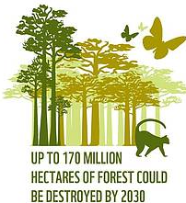
Wild fire
Kettle ranching
Illegal Logging

Slide 3
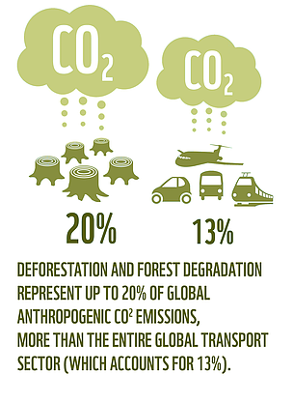
Protect the existing
Re-stablish

Slide 4
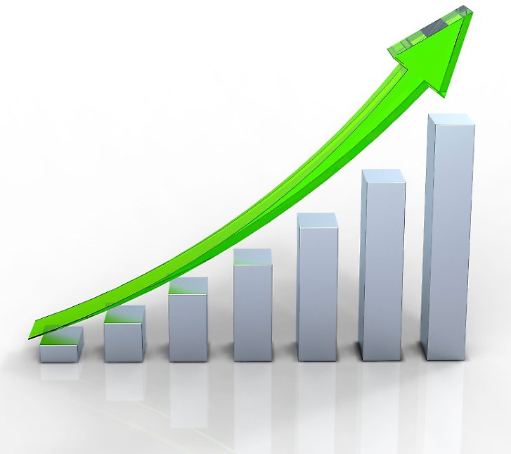

Protect the existing
Re-stablish
Accelerate performance
Machine Learning

Slide 5
Predicting Forest Activity and Action Recommending System

Slide 6
Methodology
Data Collection
Classification
End user Data visualization

Slide 7
Sound, Temperature, Gas, humidity, motion
Government sector
Community
Environmental activist
Environmental Expert
Train CNN machine learning for classification and action recommending

